Slide 1
Introduction to FPGA Simulation and Debug

Slide 2
Objective
Understand and select appropriate debugging tools for FPGA designs.
Hands on use of four different FPGA debug tools
Simulation
Modelsim
Actual Hardware
In-System Sources and Probes
Signal Tap Logic Analyzer
System Console Instrumentation

Slide 3
Simulation with ModelSim

Slide 4
Why Simulation?
+ Include wide range of analyses
+ Reduce development costs
+ Brings innovative products faster to market
+ Provide results that are impossible to measure on physical prototype.
+ High visibility of all signals in design
- Can take a very long time to run for large designs or excessive stimulus
- Designer has to predict and create stimulus that matches actual behavior

Slide 5
Testbenches
TESTBENCH
A test bench or testing workbench is an environment used to verify the correctness or soundness of a design or model.
Design Under Test
(DUT)
Stimulus
Output

Slide 6
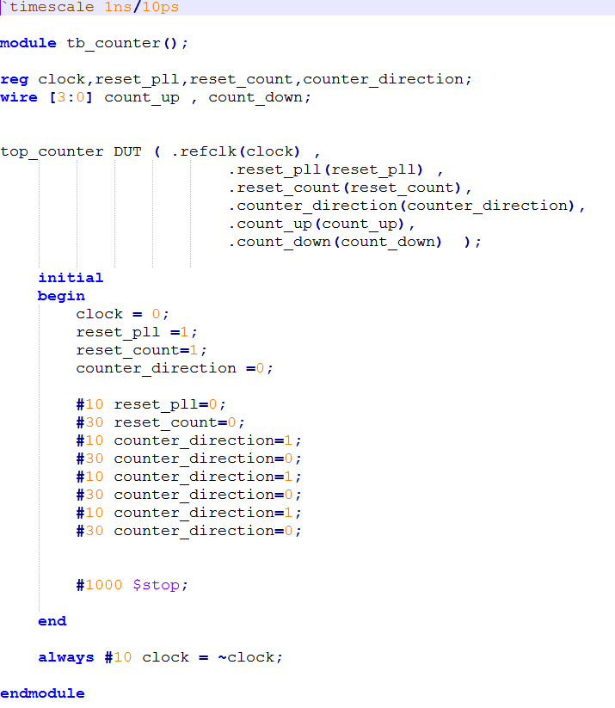
Verilog Testbench Constructs
Timescale
1st number is units, second is timing resolution
Inputs are reg, outputs are wires
Note: no module I/O
Initial Block
Runs only once (vs always block)
Stimulus
Best to change stimulus on the inactive edge of the clock – easier to read waveforms
Use $stop vs $finish or simulator closes
Clock

Slide 7
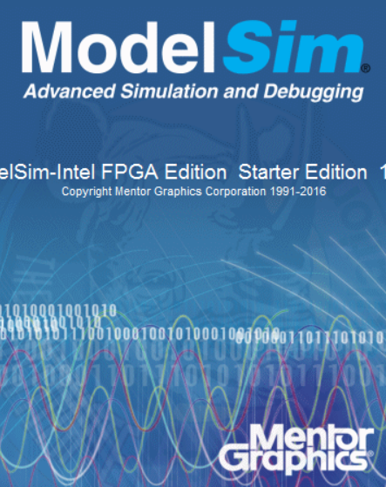
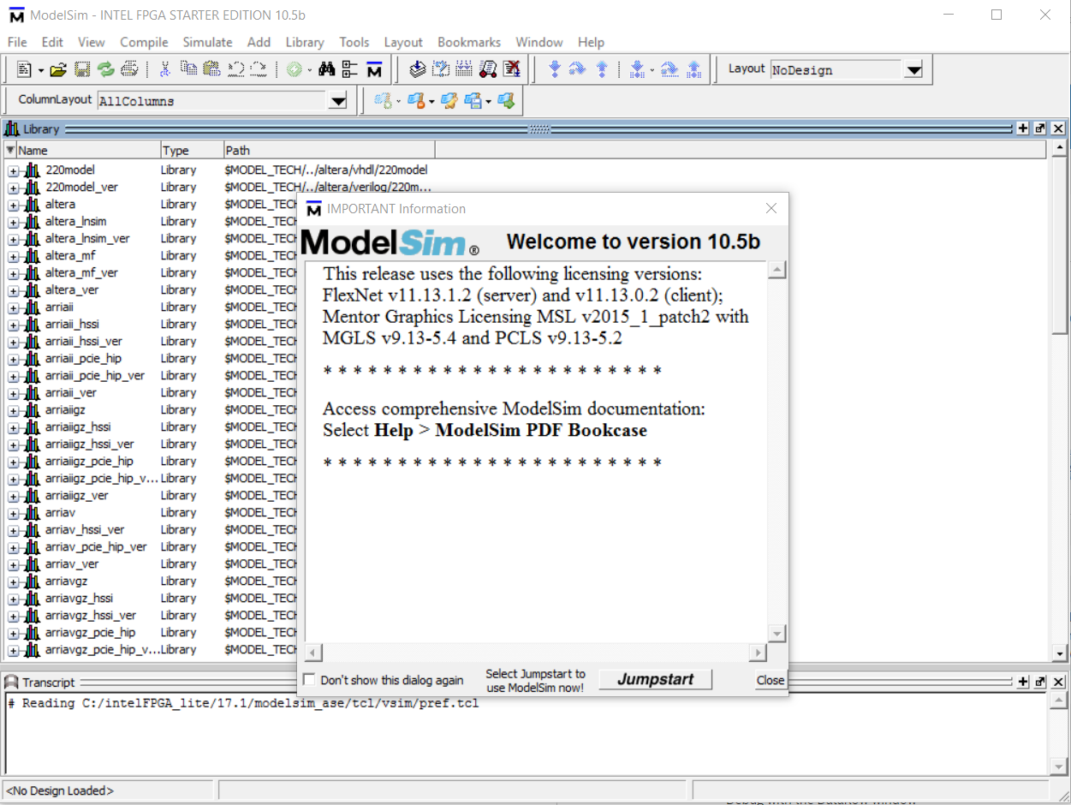
Mentor ModelSim Overview
ModelSim is a multi-language HDL (Verilog/VHDL) simulation environment. It can be used independently or Intel Quartus can create startup scripts and link designs to ModelSim.
Intel Quartus has a license to distribute Modelsim-Altera with Quartus .
Free Starter Edition: <=10K lines of code, runs slower

Slide 8
ModelSim
Create Project
Performed in Quartus
Compile Design
Note:
Only functional (non-timing) simulation is supported
Back-annotated timing model gate level simulations are not supported
Startup Script
Simulate
This script will link in all of external IP libraries so you don’t have to
OK
NO
Fix Design
YES
Done

Slide 9
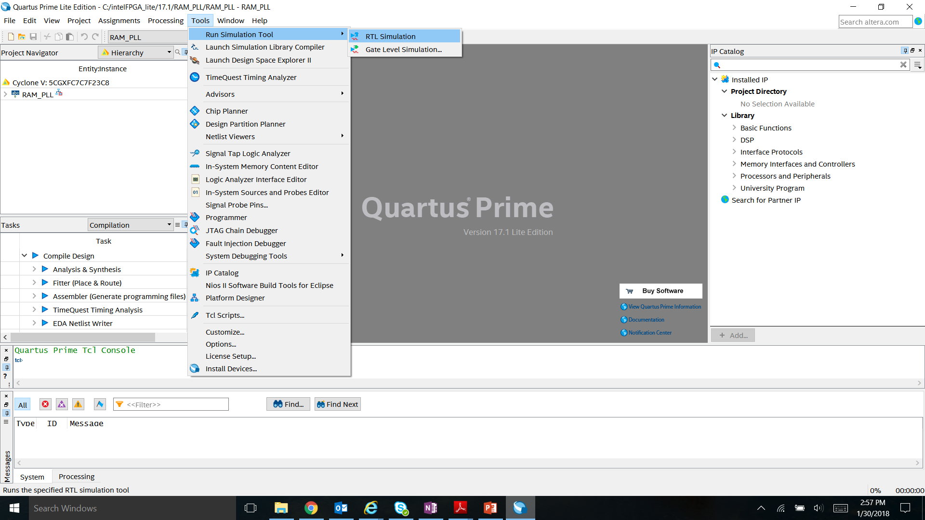
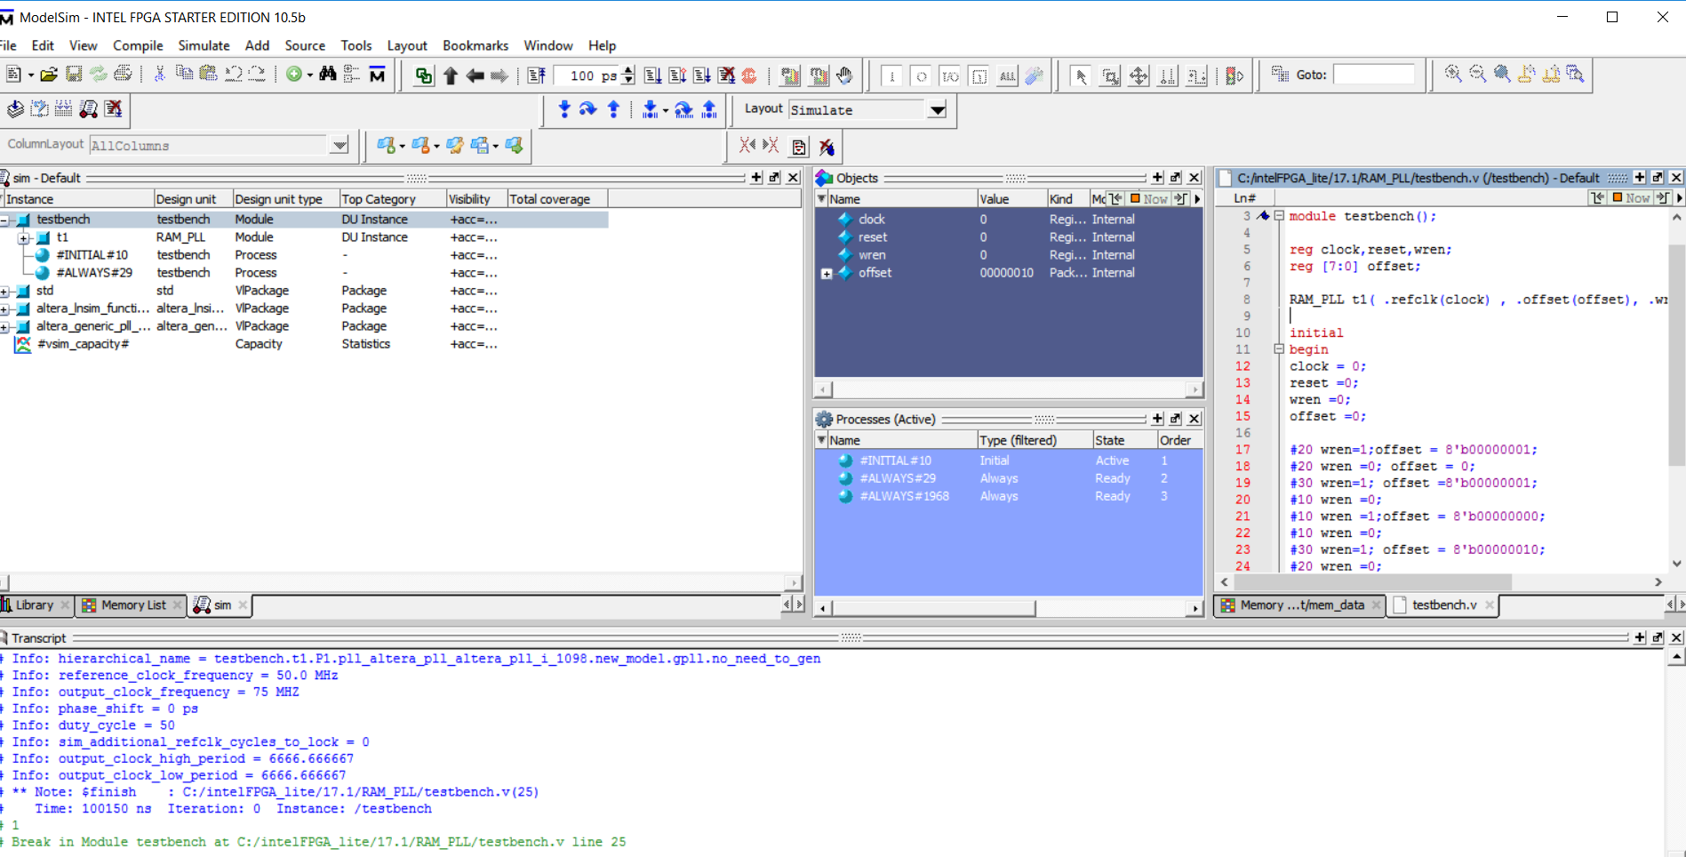
ModelSim GUI
Launching ModelSim from Quartus Tools →Run Simulation Tool → RTL Simulation
Simulation Objects
Testbench File
Command Transcript Window

Slide 10
Lab Exercise 1: MODELSIM

Slide 11
IN-System Sources and probes (issp)

Slide 12
Why ISSP
+ Quickly set signals to constants: pins or internal nodes
+ Easily monitor signals – non-triggered continuous display
+ Works on actual hardware
- Not triggered – might miss activity

Slide 13
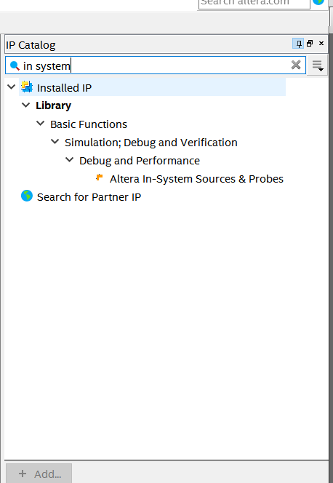
In-System Sources and Probes
ISSP allows an easy way to drive and sample signals in hardware and provides a dynamic debugging environment.
ISSP Editor consists of a probe function and interface to control the instances during run time.
It is operated over JTAG.
Each instance can drive and toggle values up to 512 signals.
Can create up to 128 instances of ISSP using IP Catalog

Slide 14
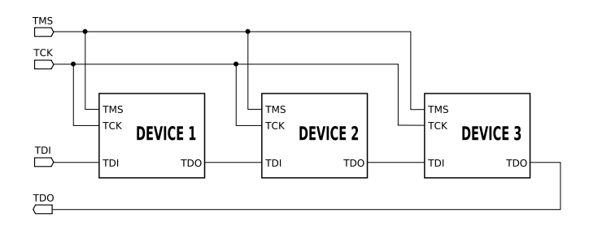
What is JTAG - Joint Test Action Group (IEEE 1149)
JTAG = JTAG is an industry standard for verifying designs and testing printed circuit boards after manufacture. JTAG implements standards for on-chip instrumentation in electronic design automation as a complementary tool to digital simulation.
FPGAs use this bus as one of the means to configure the device and interface with internal structures in the device
Standard 4 or 5 wire bus – used in many digital electronic devices for test and device specific configuration

Slide 15
USB Blaster Bridge Circuit
Development Kit with Integrated USB Blaster
Host PC
USB to JTAG Bridge
FPGA
FTDI
USB
JTAG
This device is commonly a small MAX series non-volatile device

Slide 16
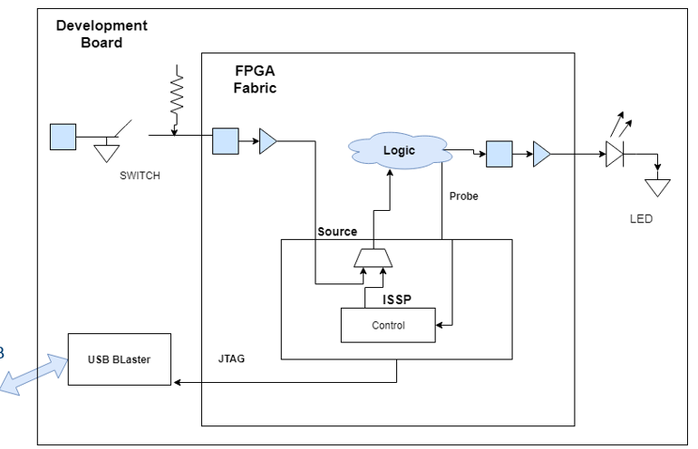
In-System Sources and Probes Block Diagram
Host PC
Host PC

Slide 17
Example Uses
Prototype a front panel with virtual buttons for a FPGA Design
Monitor results of changing design constants
Extensive TCL scripting support to create custom automated design control interfaces

Slide 18
SignalTap
Embedded Logic Analyzer

Slide 19
Why Signal Tap
+ Easily monitor signals – using simple to elaborate triggering schemes
+ No external equipment required
+ Don’t need to figure out stimulus since its based on actual hardware
Uses up lots of memory resources inside the chip
Can change timing of design
Requires recompile which takes time

Slide 20
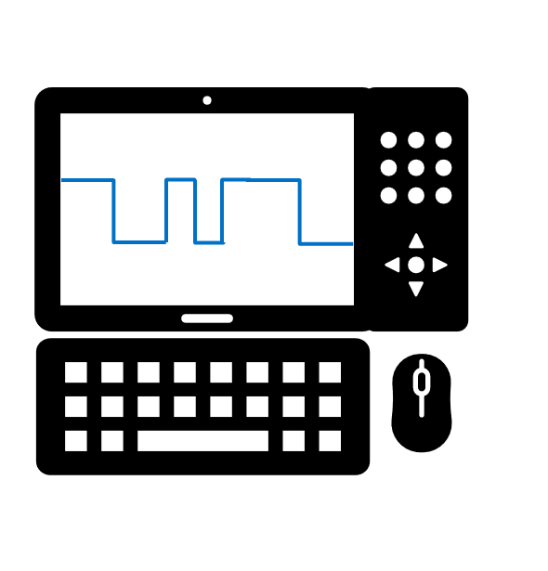
Debug of a Design with an External Logic Analyzer
Pros:
System-level debug
Can store large quantities of data
Flexible trigger condition
Cons
Signals must be physically accessible on the board by a probe
FPGA must have available I/O
If you need a new signal that isn’t accessible, you must make a new board
Probe equipment can potentially effect signal integrity
High quality probes prevents this, but tend to be expensive
Equipment expensive for hobbyist

Slide 21


Signal Tap Logic Analyzer
SignalTap is a logic analyzer made of available resources inside the FPGA
Uses available logic elements to implement the Logic Analyzer
Samples on-chip signals on the rising edge of a specified clock signal
View captured data through the standard JTAG connection typically used for programming the device

Slide 22
Debug of a Design with Signal Tap
Pros:
Tap signals buried deep in the design
No unassigned I/Os or routing needed
Comes free with all versions of Quartus, no external test equipment required
Tap new signals with the same board by reconfiguring, recompiling, and reprogramming (no re-spin!)
Cons
Requires additional device resources (memory and logic elements) – doesn’t change base function, but changes timing
Must have an active JTAG connection

Slide 23
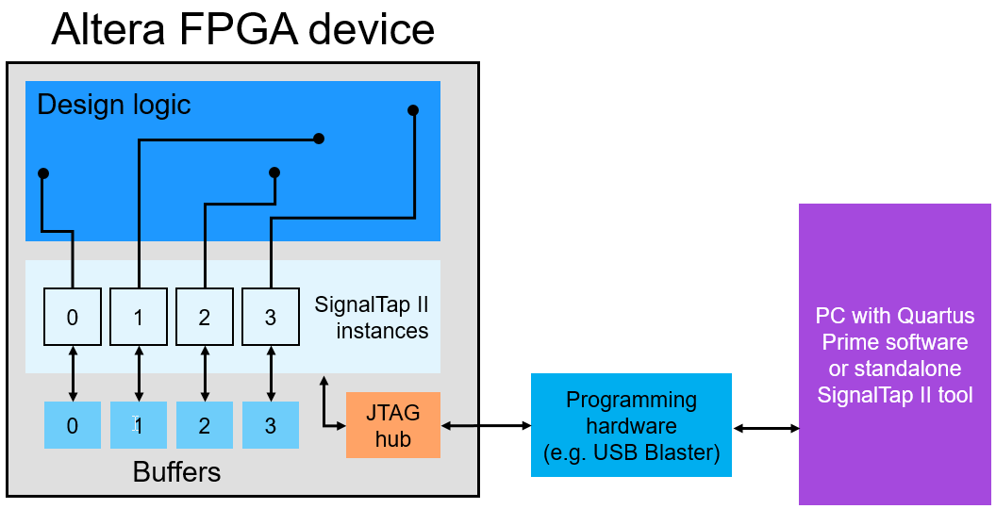
What is Signal Tap ?

Slide 24
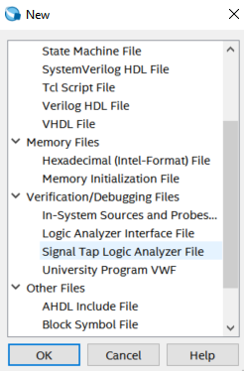
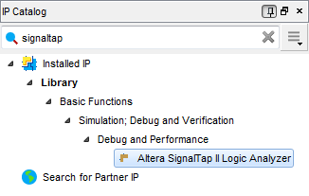
Create a Signal Tap instance in two ways
Use Signal Tap file (.stp) (recommended)
Creates a file (.stp) separate from design files
Convenient features and GUI
2. Use IP Catalog and IP Parameter Editor
Manually instantiate altera_signaltap_ii_logic_analyzer IP core directly into HDL code or Qsys (Platform Designer)
Ties the ELA to the signals directly in RTL

Slide 25
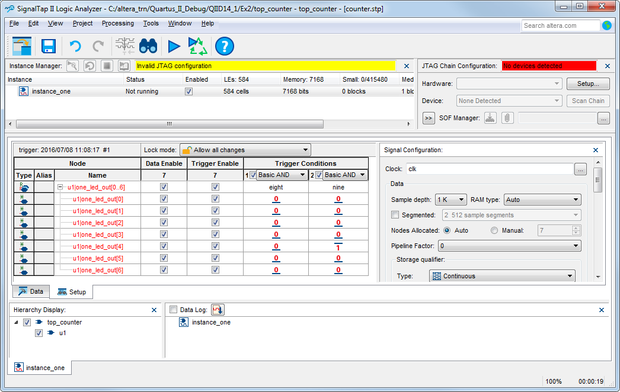
Signal Tap Logic Analyzer Window
Instance Manager
Identifies which instance is being edited in the GUI
Enable/Disable instances quickly
Gives status and resource utilization (LEs and memory)

Slide 26
Signal Tap Logic Analyzer Window
JTAG Chain Configuration
Built in “Programmer”
Scans the JTAG chain and identifies available devices

Slide 27
Signal Tap Logic Analyzer Window
Nodes List
Use the Node Finder to add signals to be tapped
Automatically groups busses together and create custom groups

Slide 28
Signal Tap Logic Analyzer Window
Trigger Conditions and Qualifiers
Data Enable: Saves signal data (disable to save memory)
Trigger Enable: Signal is part of the trigger condition (disable to save LEs)

Slide 29
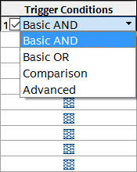
Signal Tap Logic Analyzer Window
Trigger Conditions
Add up to 10 trigger conditions
Choose how every node is compared

Slide 30
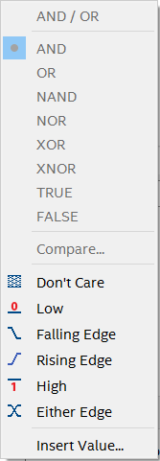
Signal Tap Logic Analyzer Window
Trigger Conditions
Add up to 10 trigger conditions
Choose how every node is compared
Choose what action triggers a specific node

Slide 31
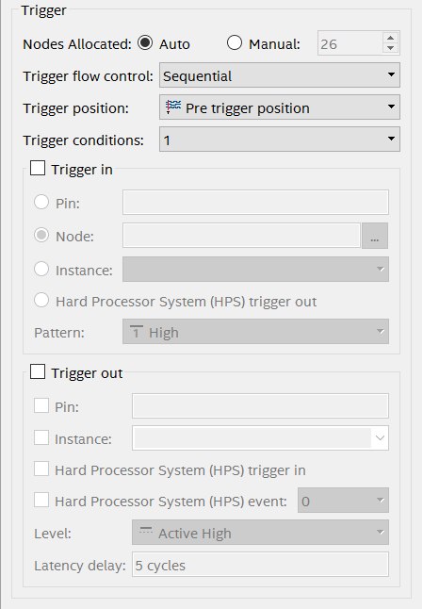
Signal Tap Logic Analyzer Window
Signal Configuration
Advanced trigger control
Select the number of trigger conditions
Trigger In/Out options

Slide 32
Signal Tap Logic Analyzer Window
Data/Setup Window
Setup allows configuration of nodes and trigger conditions (for making edits)
Data shows the acquired signal information (for viewing results)

Slide 33
Lab Exercise 2: In-SYSTEM SOURCES AND PROBES Lab Exercise 3: SIGNAL TAP

